Slide 1
Motion Planning for Multiple Autonomous Vehicles
Lateral Potentials
Elastic Strip
Rahul Kala
Presentation of paper: R. Kala, K. Warwick (2013) Planning Autonomous Vehicles in the Absence of Speed Lanes using an Elastic Strip, IEEE Transactions on Intelligent Transportation Systems, 14(4): 1743-1752.

Slide 2
Why Lateral Potentials?
Computational Time
Work with partially known environments
Issues
Completeness
Optimality

Slide 3
Key Contributions
Modelling of lateral potentials suited for road scenarios to eliminate the known problems associated with the potential approaches.
Modelling of potentials based on the principles of time to collision and cooperation apart from the distance measures for lateral planning of the vehicles.
Use of obstacle and vehicle avoidance strategy parameters for higher order planning.
Heuristic decision making in deciding these strategy parameters for real time planning.

Slide 4
Artificial Potential Fields
Goal attracts the robot, obstacles repel, both inversely proportional to the distance
Robot moves due to forces due to both factors
Repulsive force from the obstacles
Attraction force from the goal
Resultant force/ direction of motion
Source: Tiwari R, Shukla A, Kala R. (2013) Intelligent Planning for Mobile Robotics: Algorithmic Approaches, IGI Global Publishers, doi: 10.4018/978-1-4666-2074-2.
4

Slide 5
Why not Artificial Potential Fields
Oscillations in narrow corridor scenarios (like roads)
A vehicle directly in front repels one at back; no overtake
Many zero potential areas
Cooperation weakly modelled

Slide 6
Planning
Planning
Lateral Planning
Steering control
Longitudinal Planning
Speed control

Slide 7
Lateral Planning
Design methodology
Obstacles and road boundaries repel vehicle at the lateral side
The repulsion is used to decide the steering action
Sample out obstacles in a few directions
For each direction decide which side to steer and by how much

Slide 8
Lateral Potential Sources
Side
Diagonal
Forward
Back
Side
Diagonal

Slide 9
Lateral Potentials
Potential Source | Magnitude | Direction | Remarks
Forward | Time to collision | Strategy parameter, decides side of vehicle/obstacle avoidance/overtake | Time to collision enables treating and vehicles alike, unlike the distance counterpart.
Side | Distance | Each side applies a potential in the opposite side
Diagonal | Distance | Each diagonal applies a potential in the opposite side | Forerunner of side potential
Back | Time to collision | Opposite to the overtaking direction of the vehicle encountered at back | Cooperation factor

Slide 10
Front potential
Front potential strategy parameter heuristic
In case of vehicle ahead
If front vehicle more laterally at the right
If front vehicle more laterally at the left, or at equal lateral position
In case of obstacle ahead
If the obstacle sensed laterally at the left of the road
Turn left
Turn right
Turn right
If the obstacle sensed laterally at the right of the road
Turn left

Slide 11
Lateral Potentials
All combined by a weighted addition (with sign), where weights are the parameters
Lateral potential gives the preferred orientation to the direction of the road
Required steering correction to get the correct orientation is applied (subjected to constraints)

Slide 12
Parameters
Parameters
Lateral Sensitivity
Longitudinal Sensitivity
Cooperation
Mixed Sensitivity
Sensitivity to obstacles ahead
Sensitivity to the road boundaries/ obstacles at the side
Magnitude of cooperation to allow overtake
Mixture of both sensitivities

Slide 13
Longitudinal Planning
Maximum speed as per the distances recorded is set
Distance recorded in longitudinal direction and in the heading direction of the vehicle
Maximum acceleration limited by aggression factor to eliminate steep acceleration/retardation

Slide 14
Results

Slide 15
Analysis

Slide 16
Analysis

Slide 17
Analysis

Slide 18
Elastic Strip
Imagine an elastic strip representing a trajectory between a source and destination
Each obstacle acts as a source of repulsion
The elastic strip has an internal force by which it attempts to straighten itself
As the obstacles move, the strip deforms
At any time the strip represents the trajectory
Elastic Strip

Slide 19
Key Contributions
Design of a method to quickly compute the optimal strategy for obstacle and vehicle avoidance, and the associated trajectory.
Real-time optimization of the trajectory as the vehicle moves, making the resultant plan near-optimal.
Using heuristics to ensure the travel plan is near-complete.
Making the coordination strategy cooperative between vehicles.

Slide 20
Why Elastic Strip
And not Lateral Potentials
Make the resultant approach complete
Make the resultant approach optimal
Fixing strategy parameters

Slide 21
Objectives
Used to select between any competing plans at any instance of time
Go as far as possible longitudinally
Maximize lateral clearance (distance from side obstacles)
Minimize travel time
Maximize cooperation
Application of lateral potential strategy heuristic

Slide 22
Feasibility
All other vehicles assumed to be travelling at the same speed and orientation
Any point which would be occupied by the vehicle being planned can be called feasible only if:
It allows enough time for to slow down to avoid collision from the vehicle in front
It allows enough time for the vehicle at back to slow down to avoid collision from the vehicle located at the point
No collisions with obstacles or the other vehicles
A plan is feasible if all points in it are feasible

Slide 23
Terms
Term | Meaning
Trajectory | Trajectory by which the vehicle is planned to be moved
Obstacle only trajectory | Trajectory considering obstacles only and none of the other vehicles
Strategy | Specification of side (left or right) of avoiding every vehicle and obstacles

Slide 24
General Framework
Make plan as the vehicle moves
Start will a null plan
As the scenario changes:
speed is set to the maximum value as per the current position
infeasible part is deleted
plan is extended
plan is optimized

Slide 25
Modes of operation
Modes
Trajectory ends at an obstacle
Trajectory does not ends at an obstacle
Normal operation, all possible subsequent plans explored
Plan extension can only happen using the strategy followed by obstacle only trajectory
Speeding up disallowed
Speed adjusted to make vehicle standstill at a distance d_{o}

Slide 26
Modes of operation
Trajectory (overcoming obstacle not possible due to blue vehicle)
d_{o}
Obstacle
Obstacle only trajectory
Need to stop here. On going further there is a risk of stopping too close to the obstacle, preventing further motion even by greatest steering.
More close the trajectory to the trajectory without obstacle, more away is the final position of the vehicle from the obstacle, lesser the d_{o}.

Slide 27
General Framework
Plan ends with static obstacle
Mode
Plan does not end with static obstacle
Compute maximum speed
Trim Plan
Optimize Plan
Extend Plan
Map
Current Plan
Control
Vision

Slide 28
Plan Extension
Speed change not allowed
Lateral potential speed indicator used as granularity of motion generation
Granularity finer near the obstacle in front and coarser at a distant
Use Lateral Potential to decide unit move
Extrapolate the motion of the other vehicles to create scenario at the next time step
If a new vehicle or obstacle is found, thy both left and right sight avoidance strategies separately
Out of all plans formed by various strategies, select the best plan

Slide 29
Plan Extension
The strategy corresponding to the selected best plan is used for further plan extension calls
If the plan ends with an obstacle
additionally an obstacle only trajectory is computed
main trajectory is re-generated using the strategy that resulted in obstacle only trajectory
this results in similarity between an obstacle only trajectory and the main trajectory

Slide 30
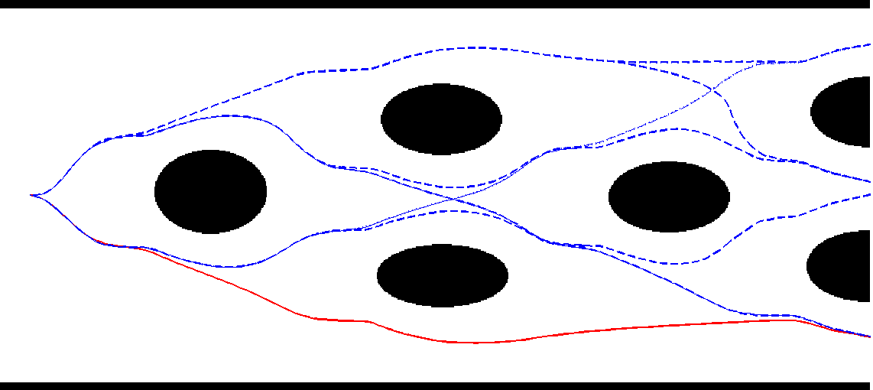
Plan Extension
All plans
Optimal plan

Slide 31
Plan Optimization
A trajectory represents an elastic strip
A number of waypoints are uniformly taken at the strip
Each waypoint is acted upon by forces by which it moves
Weighted addition of forces is taken
Only lateral component of the force is considered

Slide 32
Path Optimization
Force | Role
Lateral force | Obstacles at side repel the waypoint in opposite direction
Spring extension force | Strip tries to straighten itself, corresponding waypoints attract
Cooperation force | A vehicle at back attempting overtake repels waypoint in the direction opposite to that of overtake
Drift force | Main trajectory is drifted towards obstacle free trajectory, if any.

Slide 33
Path Optimization
Main trajectory or obstacle free trajectory
Main Trajectory – if followed, gets the vehicle too close to the obstacle
Obstacle
Drift
Obstacle only trajectory – if followed, vehicle would need to wait for the blue vehicle very early
Concept: Drift main trajectory towards obstacle free trajectory as long as collision with blue vehicle can be avoided

Slide 34
Path Optimization
Actual position
Repulsion by blue vehicle
Projected position at the time of arrival
Repulsion by road boundary and green vehicle
Elastic Strip
Spring attractive force

Slide 35
Plan Optimization
Initial Plan
Optimized plan (with the sole aim of maximizing the average clearance)
Optimized plan

Slide 36
Results

Slide 37
Results

Slide 38
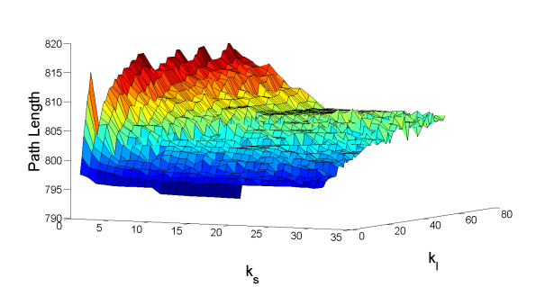
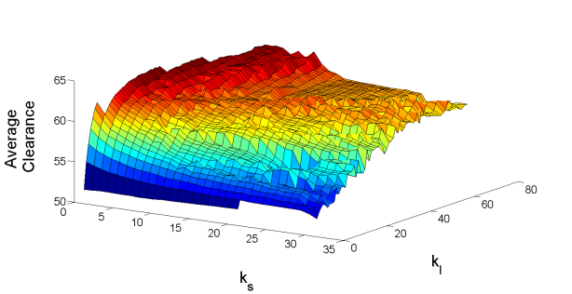
Analysis

Slide 39
Thank You
Acknowledgements:
Commonwealth Scholarship Commission in the United Kingdom
British Council

